Slide 1
Create Information with Formulas
Formulas:
Allow you to perform basic mathematical calculations
Can contain:
Cell references
Constants
Functions
Mathematical operators
Notes:
A formula allows you to perform basic mathematical calculations using information in the active worksheet and others to calculate new values. Formulas can contain cell references, constants, functions, and mathematical operators.
Information on creating information with formulas continues on the next slide.

Slide 2
Create Information with Formulas
Formulas:
Always begin with =
Use the operators:
+ or – (addition or subtraction)
* or / (multiplication or division)
^ (powers or exponentiation)
Notes:
Formulas in Excel have a specific syntax. In Excel, formulas always begin with an equal sign (=). Formulas can contain references to specific cells that contain information; a constant, which is a number that never changes, such as the value for π (pi) and mathematical operators such as +, – , *, /, ^; and functions.
Information on creating information with formulas continues on the next slide.

Slide 3
Create Information with Formulas
Excel’s order of operations:
1. Parentheses
2. Exponentiation
3. Multiplication and division
4. Addition and subtraction
Notes:
Excel’s order of operations is the same that you learned in your mathematics classes, operations are performed in the following order:
1. Parentheses
2. Exponentiation
3. Multiplication and division
4. Addition and subtraction
See Table 5 in the textbook for examples and results of applying these order of operations.

Slide 4
Use Conditional Formatting to Assist Decision Making
Conditional formatting:
Allows the specification of rules when formatting a cell
Changes the visual presentation of information to add information
Highlights information by changing cell:
Fill color
Font color, style, and size
Border
Number format
Notes:
Conditional formatting allows the specification of rules that apply formatting to a cell as determined by a rule outcome. It is a way to dynamically change the visual presentation of information in a manner that adds information to the worksheet.
Conditional formatting can be used to highlight information by changing cell fill color, font color, font style, font size, border, number format, and by adding visual cues such as scales and icons.
Information on using conditional formatting to assist in decision making continues on the next slide.

Slide 5
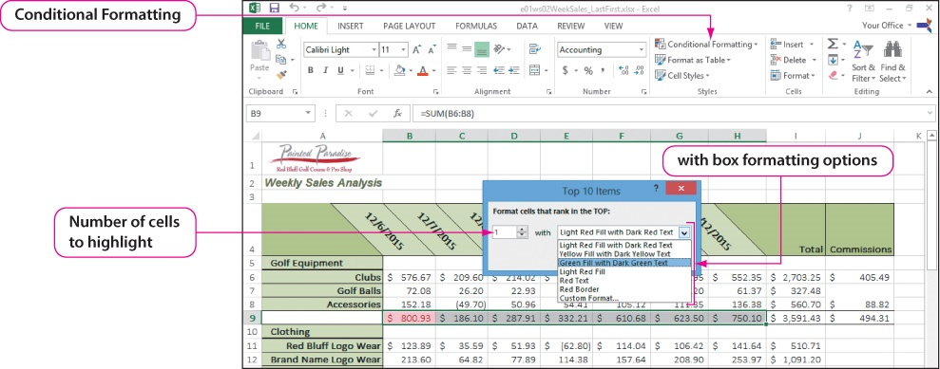
Use Conditional Formatting to Assist Decision Making
Notes:
We cannot examine all the conditional formatting rules. In this slide, you see how to highlight the high values.
The condition formatting options are displayed by clicking Condition Formatting in the Styles group on the HOME tab. A list is displayed that allows you to select from a variety of options. In the slide example, you click Top/Bottom rules and type 1, to show the top sales category, and it will be highlighted in green.
Information on using conditional formatting to assist in decision making continues on the next slide.

Slide 6
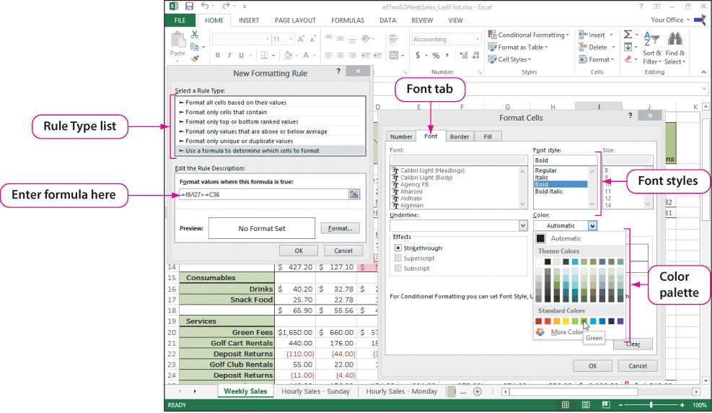
Use Conditional Formatting to Assist Decision Making
Notes:
In this example, you see how to apply conditional formatting using a formula to display weekly sales totals in a bold and green font if they meet or exceed benchmarks. After clicking Conditional Formatting, point to Highlight Cells Rules, and then select More Rules. In the New Formatting Rule dialog box, under Select a Rule Type, click Use a formula to determine which cells to format. In the Format values where this formula is true box, type =I9/I27>=C36 (golf equipment percentage of total sales compared to the golf equipment benchmark percentage of sales). Click Format. On the Font tab, in the Font style box, click Bold. Click the Color arrow, and Under Standard Colors, click Green.
Conditional formatting can be removed from a selected cell or cell range, and it can be removed from the entire sheet. To remove Conditional Formatting from the selected range, in the Styles group, click Conditional Formatting, and then click Manage Rules. In the Conditional Formatting Rules Manager dialog box, click the Show formatting rules for arrow, and then select Current Selection. The Conditional Formatting Rules Manger displays the rules applied in the currently selected cells. Click Delete Rule and click OK to remove the conditional formatting.

Slide 7
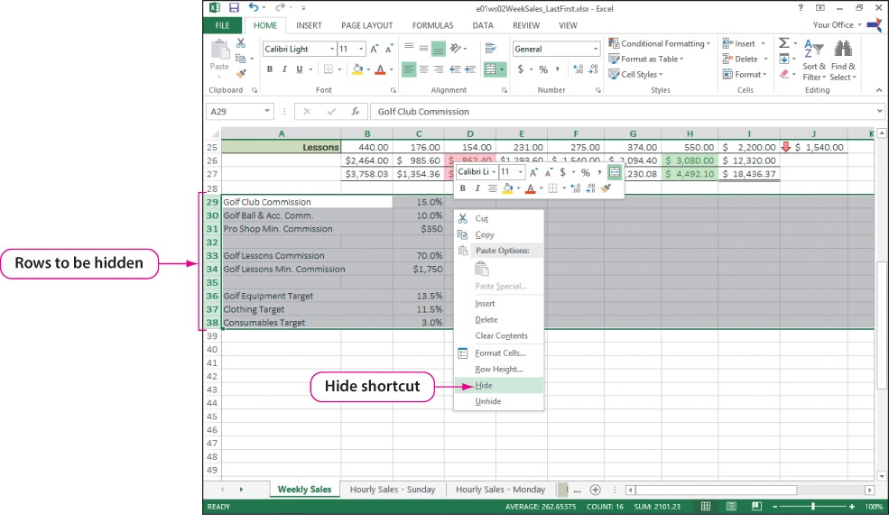
Hide Information in a Worksheet
Notes:
You can hide cells by simply selecting the rows or columns to be hidden and clicking on the row or column heading. Right-click with the mouse pointer over the heading, and click Hide on the shortcut menu that appears.
In the example shown in the slide, we are hiding rows 29:38. Click the heading for row 29, hold Shift, and click the heading for row 38. Right-click anywhere in the selected rows and select Hide on the shortcut menu.

Slide 8
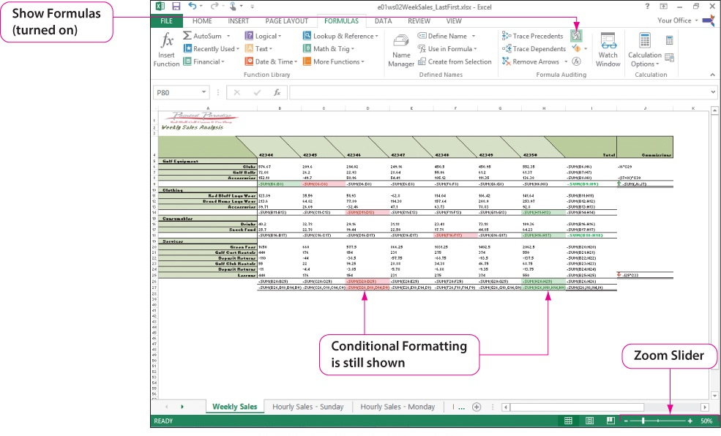
Document Functions and Formulas
Notes:
An important part of creating a good worksheet is the inclusion of documentation, and one way of doing this is to use Show Formulas, which is helpful in understanding how a worksheet is structured. It is an essential aid when correcting errors or updating the functions in a worksheet.
To display the formulas in a worksheet, click Show Formulas in the Formula Auditing group on the FORMULAS tab. To return the worksheet to normal view displaying the results of the formulas, press Show Formulas again. You can also show and hide formulas by using the keyboard shortcut Ctrl + ~. If you have never used the tilde (~) before, on most keyboards it is located at the top-left of the keyboard.
To produce a printed copy of the worksheet showing the formulas, you can print it in the PDF (Portable Document Format) format. Click the FILE tab, click Export, and click Create PDF/XPS. In the Publish as PDF or XPS dialog box, you have the usual options of naming the file and specifying its location. You also have the option of opening the file after you publish it. To view a PDF file, you need a PDF reader such as Modern Reader or Adobe Acrobat Reader.

Slide 9
Understand the Types of Cell References
Cell references:
Relative = C3+D3
Absolute = $D$4/$E$5
Mixed = $F6+E$6
Notes:
Integrating cell references within formulas and working with functions are common methods used in developing effective spreadsheets.
There are three types of cell references:
Relative cell references that change when the formula or function is copied to another location
Absolute cell references that do not change if a formula or function is copied to another location
Mixed cell references are essentially a combination of relative and absolute cell references
Notice the use of the dollar sign when using absolute and mixed cell references.
Still do not understand the differences? The diagrams shown on the next three slides should help.
Information on understanding the types of cell references continues on the next slide.

Slide 10
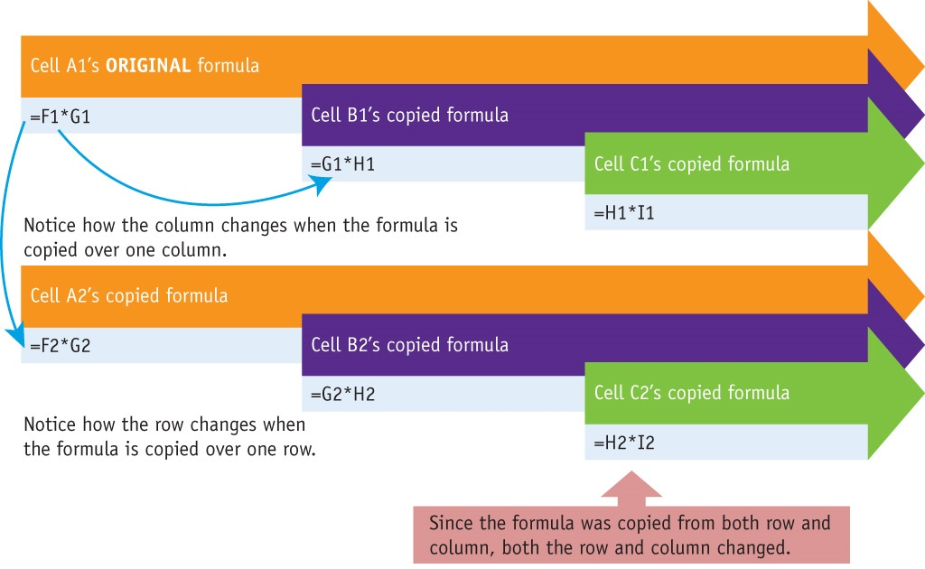
Understand the Types of Cell References
Notes:
Relative cell referencing is useful in situations where the same calculation is needed in multiple cells but the location of the data needed for the calculation changes relative to the position of the calculation cell. Take the time necessary to study and understand the diagram.
Information on understanding the types of cell references continues on the next slide.

Slide 11
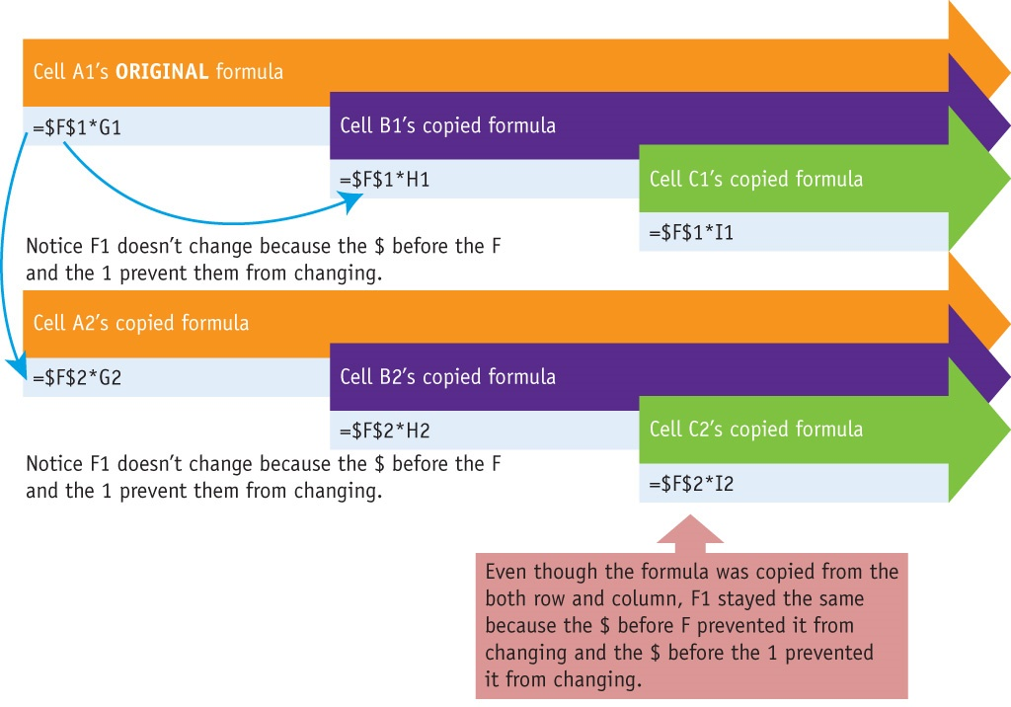
Understand the Types of Cell References
Notes:
Absolute cell referencing is useful when a formula needs to be copied and the reference to one or more cells within the formula must not change as the formula is copied. Thus information on understanding the types of cell references continues on the next slide. In this example, the column and row address of a referenced cell remains constant regardless of the position of the cell when the formula is copied to other cells. Take the time necessary to study and understand the diagram.
Information on understanding the types of cell references continues on the next slide.

Slide 12
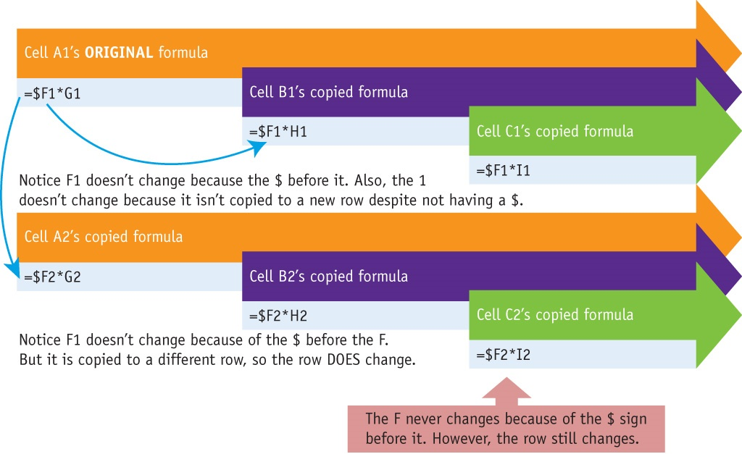
Understand the Types of Cell References
Notes:
Mixed cell references refer to referencing a cell within the formula where part of the cell address is preceded by a dollar sign to lock—either the column letter or the row value—as absolute reference. This leaves the other part of the cell as relatively referenced when the formula is copied to new cells. Take the time necessary to study and understand the diagram.
When creating an absolute or mixed cell reference, you can use the keyboard shortcut F4.
Press F4 one time to place a $ in front of both the column and row value (absolute reference).
Press F4 a second time to place a $ in front of the row value only (mixed reference).
Press F4 a third time to place a $ in front of the column value only (mixed reference).
Press F4 a fourth time to remove all $ characters (relative reference).

Slide 13
Create Named Ranges
Named range – a named group of cells
Named range – either a single cell or a group of cells
Select the range and use the Name Box to create the name
There are criteria for naming ranges
Notes:
A named range is a group of cells that have been given a name, which you can then use within a formula or function. Named ranges are an extension of cell references and provide a quick alternative for commonly used cell references or ranges. The use of named ranges also adds to the documentation of your workbook. A named range can be either a single cell or a group of cells. One way to name a range is to select the range and use the Name Box to create the name.
The following is a list of conventions to use when creating named ranges:
Names for ranges must start with a letter, an underscore ( _ ), or a backslash ( \ )
Create names that provide specific meaning to the range being named
Spaces cannot be used while creating a named range. Instead use an underscore, use a hyphen character, or capitalize the first letter of each word
Do not use combinations of letters and numbers that resemble cell references
Using named ranges in place of cell references is a simple process. Instead of typing the cells that you want to use in a formula, you can type the range name you have created.

Slide 14
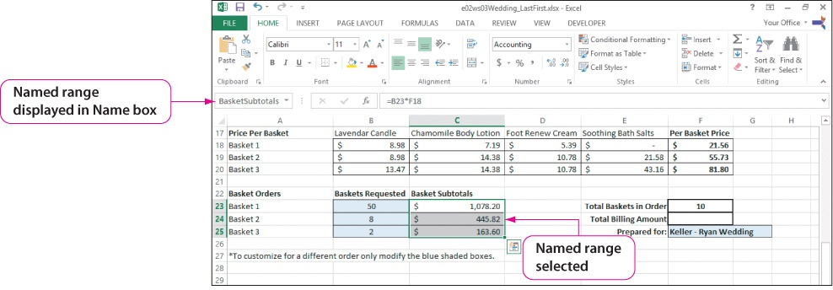
Create Named Ranges
Notes:
To name a range, you select the range of cells, click in the Name box, and type the desired range name. Using named ranges in place of cell references is a simple process. Instead of typing the cells that you want to use in a formula, you can type the range name you have created.
In the worksheet shown in the slide, the range C23:C5 has been named BasketSubtotals. To add these subtotals, instead of writing =Sum (C23:C25), you can write =Sum (BasketSubtotals). Notice two things: the second example using the range name documents what is being added, and the range name BasketSubtotals follows the range naming convention discussed in the previous slide.
Like any useful feature, named ranges can be overused. Named ranges make it easy to understand formulas and can be used to select a range of cells quickly.
Information on creating named ranges continues on the next slide.

Slide 15
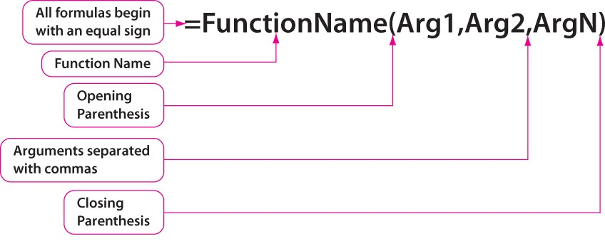
Create and Structure Functions
Notes:
A function is a named calculation where Excel calculates the output based on the input provided. Arguments are any inputs used by a function to compute the solution. Some functions, such as the TODAY function, do not have any arguments. In the case of such functions, you still use the parentheses and write TODAY( ).
Information on creating and structuring functions continues on the next slide.

Slide 16
Create and Structure Functions
Some function categories:
Database
Date & Time
Financial
Logical
Lookup & Reference
Math & Trig
Statistical
Notes:
Excel has many functions, which are categorized by application areas. Shown in the slide is a partial list of categories, most of which we examine in this workshop.

Slide 17
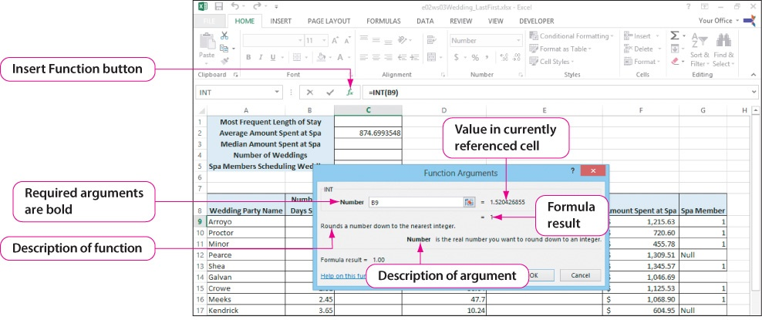
Use and Understand Math and Statistical Functions
Notes:
There are two common methods for creating functions: by using the Function Arguments dialog box and by typing the function in the cell. The Function Arguments dialog box provides additional information and previews results of the formula being constructed. When first developing the skills for using functions in Excel, you might find the Function Arguments dialog box can be very useful. As you gain more experience with functions, the Function Arguments dialog box might become less useful, particularly when nesting multiple functions together.
The example shown in the slide uses the INT (integer) function. After selecting the cell, click Insert Function, which is located to the left of the formula bar. Click the Or select a category, select Math & Trig, scroll to the desired function, click it, and click OK. After entering the needed information in the Function Arguments dialog box, click OK.
Information on using and understanding math and statistical functions continues on the next slide.

Slide 18
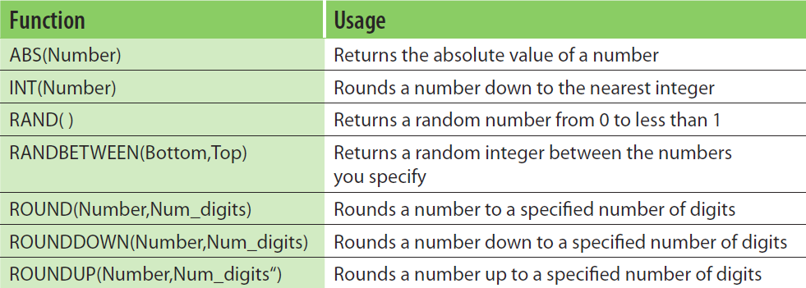
Use and Understand Math and Statistical Functions
Notes:
The table shown in the slide shows some commonly used math functions. Notice the first two functions have a single argument, the third has no arguments, and the last four all have two arguments.
Information on using and understanding math and statistical functions continues on the next slide.

Slide 19
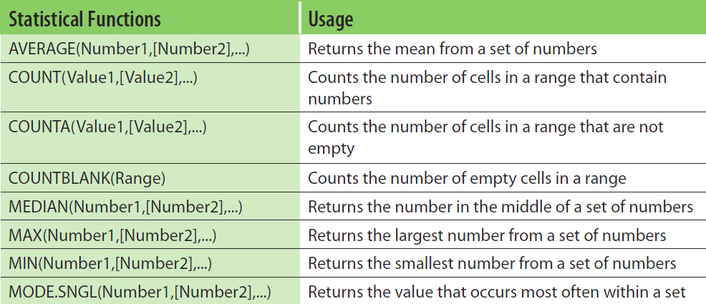
Use and Understand Math and Statistical Functions
Notes:
The table shown in the slide shows some commonly used statistical functions that can be used in summarizing a worksheet. Be sure you understand the differences among the COUNT functions.
Information on using and understanding math and statistical functions continues on the next slide.

Slide 20
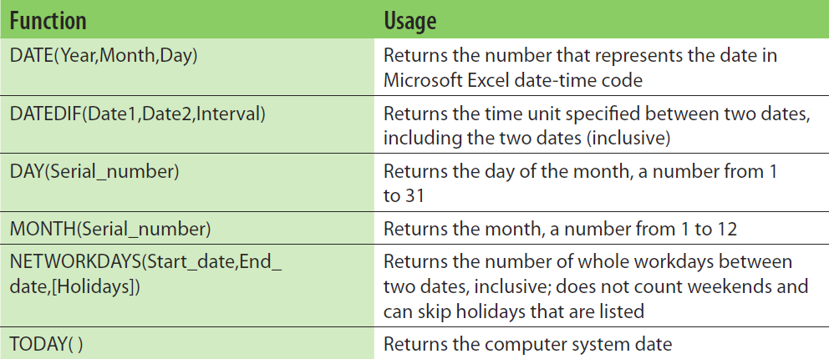
Use and Understand Date and Time Functions
Notes:
Date and time functions are useful for entering the current day and time into a worksheet as well as calculating the intervals between dates. These functions are based on a serial date system where each day is represented sequentially from a starting point. In Microsoft applications, that standard is 1/1/1900, which has a serial number of 1.
The table shown in the slide shows some commonly used date functions. For an expanded table, see Table 5 in the textbook.
Information on using and understanding date and time functions continues on the next slide.

Slide 21
Use and Understand Date and Time Functions
Notes:
Time is represented by the decimal portion of a number. The decimal is based on the number of minutes in a day (24*60=1440). Thus, a 0.1 decimal is equal to 144 minutes. A full date and time value—such as 5/14/2015 8:35 AM—appears as 42138.35804. There are 42138 days between 1/1/1900 and 5/14/2015. The time of 8:35 AM is represented by the .35804 portion of the number.
The table shown in the slide shows some commonly used time functions.

Slide 22
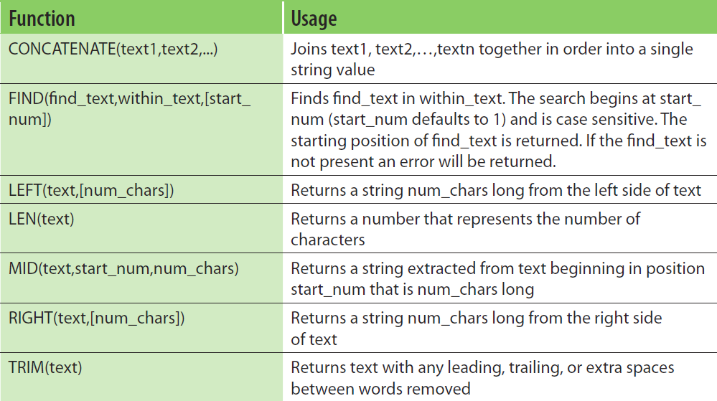
Use and Understand Text Functions
Notes:
Text functions help manage, manipulate, and format text data. Data stored as text is commonly referred to as a string. Text functions can change the way data is viewed, cut a string of text into multiple pieces, or combine multiple pieces of text together into one string of text. Text functions can be used to change the appearance of data, such as displaying text in all lowercase letters. Text functions can also be used to cleanse text. Cleansing text involves removing unwanted characters, rearranging data in a cell, or correcting erroneous data.
The table shown in the slide shows some commonly used text functions. For an expanded table see Table 8 in the textbook.
Information on using and understanding text functions continues on the next slide.

Slide 23
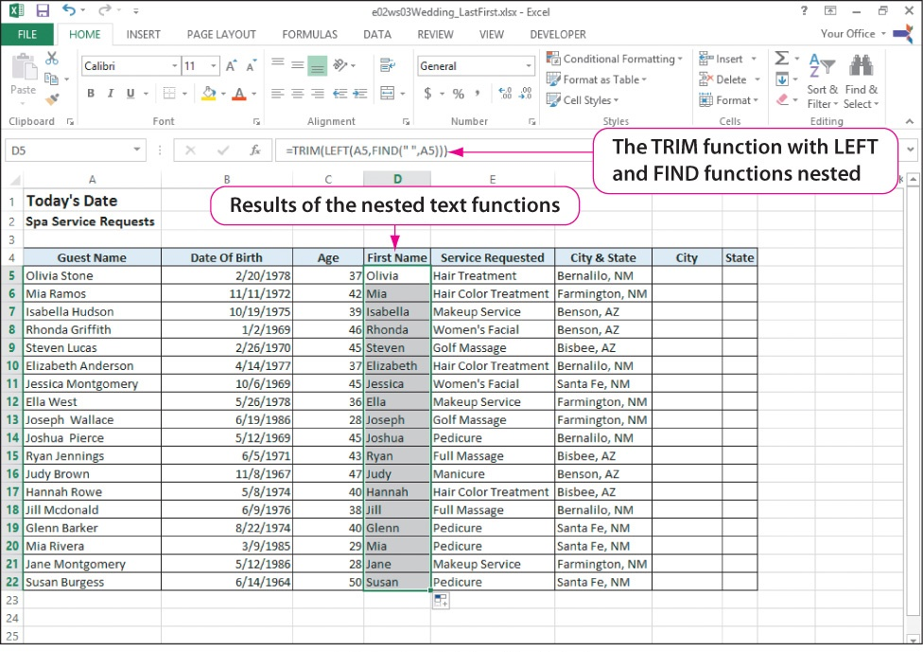
Use and Understand Text Functions
Notes:
In the example shown in the slide, we want to separate the first names from the first names last names displayed in the first column. To do this, ask yourself where the first name is located and what separates in from the last name. The first name begins at the left of the string of names and is separated from the last name by a space. Using these facts and the three text functions shown in the table on the previous slide—TRIM, LEFT, and FIND, we can separate the first name and place it in a new column of first names.
You have to be careful to have balanced parentheses. That is, in the following example, there are three left parentheses and three right parentheses.
=TRIM(LEFT(A5,FIND(“ “, A5)))

Slide 24
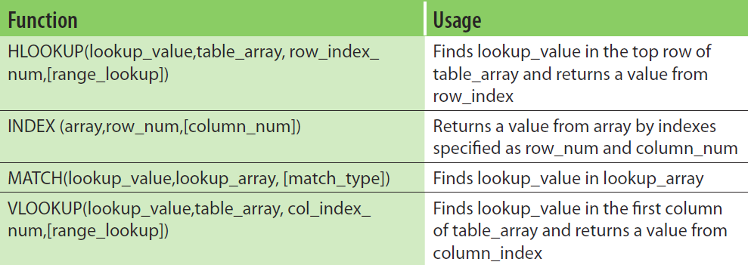
Use Financial and Lookup Functions
Notes:
Lookup and reference functions look up matching values in a table of data. Lookup and reference functions can be used for simple matches or complex retrieval tasks.
The table shown in the slide shows commonly used lookup and reference functions.
Information on using financial and lookup functions continues on the next slide.

Slide 25
Use Financial and Lookup Functions
Notes:
In this example, the VLOOKUP function is used to determine the amount of discount that should be given based on the total cost of an event.
The syntax of the function is VLOOKUP(lookup_value, table_array, col_index_number, [range_lookup])
The specific arguments for the function are:
B3–the location of the total cost
E4:F8–the location of the discount table
2–return the value in the second column
TRUE–perform an approximate match
Information on using financial and lookup functions continues on the next slide.

Slide 26
Use Financial and Lookup Functions
Notes:
When working with financial functions, several terms must be understood in order to select the correct function and use it properly.
Financial Term Definition
APR The annual percentage rate; an interest rate expressed in an annual equivalent
Compounding interest A process of charging interest on both the principal and the interest that accumulates on a loan
Interest payment The amount of a payment that goes toward paying the interest accrued
NPV The net present value of future investments
Period The time period of payments, such as making payments monthly
Principal payment The amount of a payment that goes toward reducing the principal amount
Principal value The original amount borrowed or loaned
PV Present value—the total amount that a series of future payments is worth now
Rate (and APR) The interest rate per period of a loan or an investment
Simple interest The interest charged on the principal amount of a loan only
Term The total time of a loan, typically expressed in years or months
Time value of money Recognizing that earning one dollar today is worth more than earning one dollar in the future
Now that we understand the terms, the table shown in the slide shows commonly used financial functions.
Information on using financial and lookup functions continues on the next slide.

Slide 27
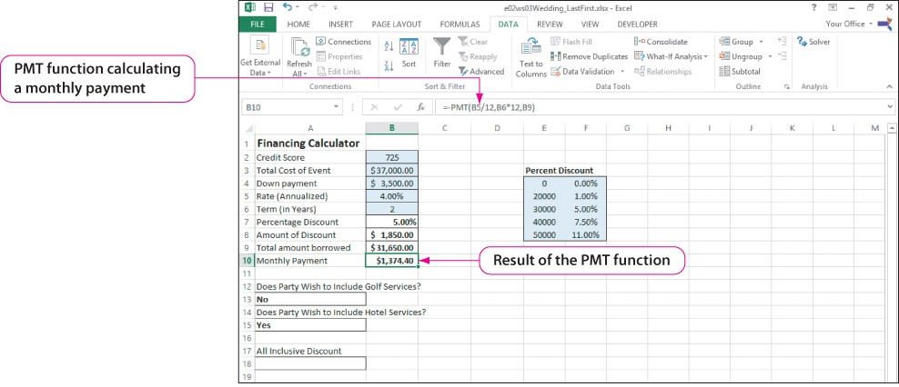
Use Financial and Lookup Functions
Notes:
In this example, the payment (PMT) function is used to determine the periodic payment for a loan.
The syntax of the function is PMT(rate,nper,pv,[fv],[type])
The specific arguments for the function are:
B5/12–the location of the interest (rate): Why is the rate divided by 12?
B6*12–the location of the number of years (npr): Why is the number of years multiplied by 12?
B9–the location of the total amount borrow (pv)

Slide 28
Use Logical Functions and Troubleshoot Functions
Notes:
Logical functions evaluate statements, or declarations, as being either true or false. All logical functions are based on an expression about a position or statement that Excel will evaluate and return as true or false. Frequently, these expressions involve comparison operators. You are familiar with the first three operators shown in the table, and you can probably see the rationale for the last three operators. Do you understand the meaning of the last one?
Information on using logical functions and troubleshooting functions continues on the next slide.

Slide 29
Use Logical Functions and Troubleshoot Functions
Notes:
The table shown in the slide shows commonly used logical functions. The AND function returns TRUE if all logical tests supplied are true; otherwise, it returns FALSE. The OR function returns TRUE if any one logical test supplied is true; otherwise, it returns FALSE.
Information on using logical functions and troubleshooting functions continues on the next slide.

Slide 30
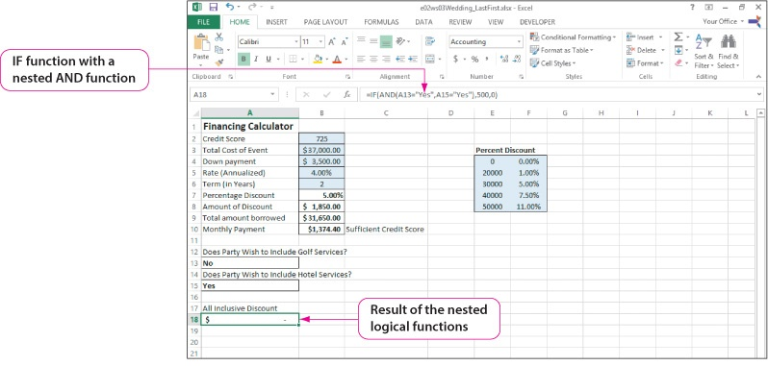
Use Logical Functions and Troubleshoot Functions
Notes:
In this example, the IF functions are used to determine whether couples use the resort for all of their wedding services, and if they do, they will be given a $500 discount.
The syntax of the AND function is AND(logical1,logical2,...)
The specific arguments for the AND function are:
A13–were golf services used (No)
A15–were hotel services used (Yes)
Because the first logical result is FALSE and the second one is TRUE, the result of the AND function is FALSE.
The syntax of the IF function is IF(logical_test,[value_if_true],[value_if_false])
The specific arguments for the IF function are:
FALSE–the result of the AND function
500–the discount for using both services (the value if true)
0–no discount (the value if false)
Note that quotation marks must be used in an IF function to return text values. To return numeric data, you do not use quotation marks.
Information on using logical functions and troubleshooting functions continues on the next slide.

Slide 31
Use Logical Functions and Troubleshoot Functions
Common function error messages:
#NAME?
#REF!
#N/A
#VALUE!
#DIV/0!
Notes:
When you make a mistake with a function that prevents Excel from returning a viable result, Excel provides an error message.
The table shown in the slide shows common functions error messages:
#NAME?—This error indicates that text in a formula is not recognized. Excel treats unrecognized text as a named range that does not exist. This is often due to missing quotes around a text string or mistyping the function or range name.
#REF!—This error indicates a reference that Excel cannot find. This is often due to changes like a deleted worksheet, column, row, or cell.
#N/A—This error indicates that a value is not available in one or more cells specified. Common causes occur in functions that try to find a value in a list, but the value does not exist. Rather than returning an empty set—no value—Excel returns this error instead.
#VALUE!—This error occurs when the wrong type of argument or operand is used, such as entering a text value when the formula requires a number. Common causes can be the wrong cell reference that contains a text value rather than a numeric value.
#DIV/0!—This is a division by 0 error and occurs when a number is divided by zero or by a cell that contains no value. Although it can occur due to an actual error in the design of a formula, it also might occur simply due to the current conditions within the spreadsheet data.

Slide 32
Summary
Cell references:
Relative
Absolute
Mixed
Ranges:
Named
Used in formulas and functions
Notes:
There are three types of cell references—relative, absolute, and mixed.
Ranges can be named and used in formulas and functions.

Slide 33
Summary (Continued)
Excel functions:
Math and statistical
Date and time
Text
Financial and lookup
Logical
Troubleshoot functions
Notes:
Excel has an extensive collection of built-in functions:
Math and statistical
Date and time functions
Text
Financial and lookup
Logical functions
Excel helps you to troubleshoot functions by displaying a variety of error messages.

